Slide 1

INSTITUTE OF AERONAUTICAL ENGINEERING
PROJECT WORK PHASE-II
Department: Computer Science and Engineering
Project title: Optimizing Telecom Operations with Segmentation and Churn Prediction .
Mentor: Ms. K. Sangeeta , Assistant Professor, CSE Department.
Presented by –
D.Neha - 21951A05B8
Mohammed Ameesha - 21951A05A4 M.Dheeraj – 21951A0538

Slide 2
ABSTRACT
Client turnover is a major challenge for large companies, especially in the telecom sector, as it directly affects profitability. Telecom providers are increasingly focused on developing methods to predict customer churn to mitigate its negative effects. Understanding the factors that contribute to churn is essential for preventing it. This work's primary contribution is the development of a churn prediction model, which helps telecom providers identify customers at high risk of churning. We explore different data analysis scenarios and display the results using graphical representations. Our model, built using machine learning techniques, leverages large datasets and introduces a novel approach for feature design and selection. The datasets used for training, evaluation, and validation include historical customer data from previous months. We experimented with four machine learning algorithms: Logistic Regression, XGBoost, gradient-boosted machine (GBM) Trees, Random Forests, and Decision Trees. To enhance accuracy, we applied parameter tuning during training. The goal of this study is to optimize telecom operations through effective segmentation and churn prediction, ultimately improving operational efficiency and customer retention.

Slide 3
PROBLEM STATEMENT
The telecommunication industry faces significant challenges due to customer churn, where subscribers discontinue their services, leading to revenue loss and increased customer acquisition costs. This project aims to develop a machine learning model to predict customer churn by analyzing user behavior, service usage patterns, and demographic data. Accurate churn prediction enables telecom companies to proactively engage at-risk customers with retention strategies, such as personalized offers or service improvements. The goal is to enhance customer satisfaction, reduce churn rates, and ultimately increase profitability. The solution involves using various algorithms to process historical data and identify key indicators of churn.

Slide 4
OBJECTIVE
Develop a machine learning model that predicts customer churn with high accuracy. Utilize data from customer historical interactions, usage patterns, and demographic information to inform predictions.
Proactive Identification:
- Enable early detection of customers at risk of churning.
- Empower telecom companies to take proactive retention measures to address potential issues.
Personalized Interventions:
- Enhance the ability to design and deliver tailored retention strategies that resonate with individual customer needs and preferences.
- Focus on improving customer satisfaction and long-term loyalty through personalized communication and offers.
Resource Optimization:
- Allocate resources effectively by focusing on high-risk customer segments, optimizing the use of marketing and customer support efforts.
- Ensure cost-efficient retention strategies that maximize return on investment.
Business Impact:
- Achieve a significant reduction in customer attrition rates, directly lowering revenue loss.
- Enhance the overall customer experience, boosting the company’s reputation and competitive advantage.

Slide 5
INTRODUCTION
Customer churn is a critical issue in the competitive telecom industry, where high churn rates impact profitability and market share. Retaining customers is more cost-effective than acquiring new ones, making churn reduction a priority. Machine learning (ML) provides a transformative solution by analyzing historical customer data—such as service usage, demographics, and interactions—to predict churn. This allows proactive engagement with at-risk customers through personalized incentives or improved service quality. Developing a churn prediction model involves data integration, preprocessing, feature engineering, model training, and evaluation using algorithms like logistic regression, decision trees. These models identify churn patterns and provide actionable insights to guide product development, customer service, and marketing. Reducing churn enhances customer lifetime value, stabilizes revenue, and helps telecom operators transition to proactive customer management, fostering satisfaction and loyalty in a competitive market.

Slide 6
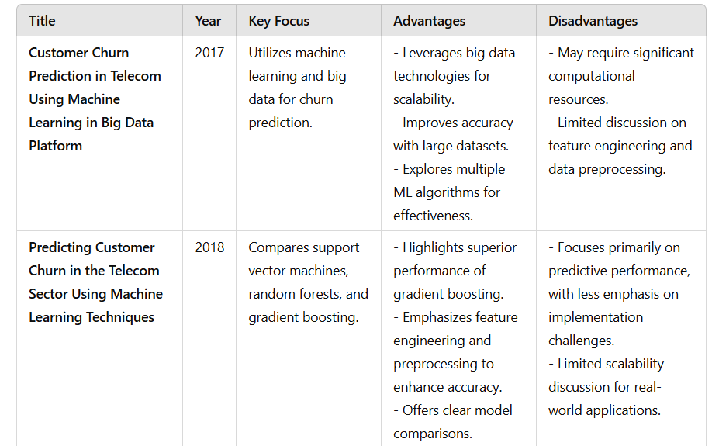
literature survey

Slide 7
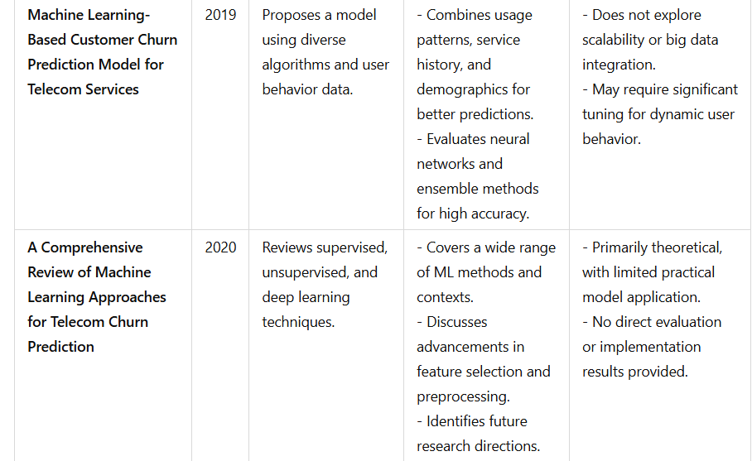
literature survey

Slide 8
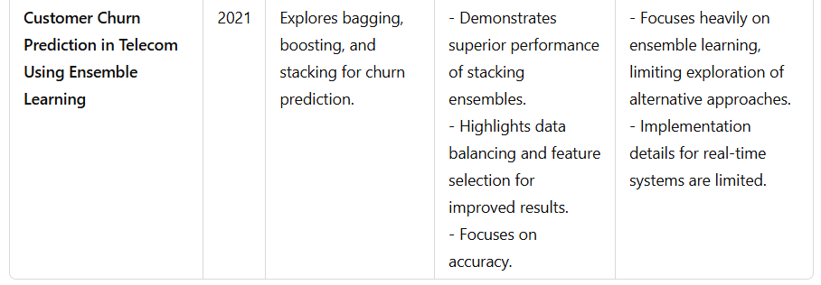
literature survey

Slide 9
EXISTING SYSTEM
Rule-Based Systems:
Description: These systems use predefined rules and thresholds based on domain expertise to flag customers as potential churn risks. For example, a rule might be set to label a customer as likely to churn if they haven’t used the service for a certain number of days.
Disadvantages:
  Static and Inflexible: Rules are fixed and may not adapt well to changing customer behaviors or market conditions.
  Limited Complexity: They fail to capture the complex, non-linear relationships in the data that often influence churn.
  High Maintenance: Regular updates and revisions by experts are required to keep the rules relevant and effective.

Slide 10
EXISTING SYSTEM
Statistical Methods:
Description: Techniques such as logistic regression and survival analysis are commonly used to model the probability of churn based on historical data. These methods rely on statistical theories to establish relationships between churn and various customer attributes.
Disadvantages:
  Assumptions and Simplifications: Many statistical models assume linear relationships and may oversimplify the data.
  Scalability Issues: They may not perform well with large and high-dimensional datasets typical in telecom.
  Less Accurate with Complex Patterns: They struggle to capture intricate patterns and interactions in customer behaviour.

Slide 11
DISADVANTAGES OF EXISTING SYSTEM
Limited Predictive Accuracy:
-Traditional methods often struggle to accurately predict churn due to their inability to handle large volumes of data and complex relationships between variables. This can result in either missing potential churners or incorrectly flagging loyal customers as risks.
Reactive Rather Than Proactive:
-Many existing systems are reactive, responding to churn indicators only after a customer shows clear signs of dissatisfaction or disengagement. This limits the opportunity to intervene early enough to prevent churn.
High False Positive and False Negative Rates:
-Rule-based and simple statistical models can produce high rates of false positives (identifying non-churning customers as churn risks) and false negatives (failing to identify actual churn risks), leading to inefficient resource allocation in retention efforts.
Poor Adaptability:
-Existing systems may not adapt well to rapid changes in customer behavior, market dynamics, or new product offerings, making them less effective over time.

Slide 12
PROPOSED SYSTEM
The proposed system leverages machine learning algorithms to predict customer churn by analyzing comprehensive customer data, including usage patterns, service interactions, and demographic factors. It employs advanced techniques such as ensemble learning and deep learning to enhance predictive accuracy and adaptability to changing customer behaviors. By integrating continuous learning capabilities, the system dynamically updates its predictions and models to stay current with evolving data trends. This proactive approach allows telecom companies to implement personalized retention strategies, improving customer satisfaction and reducing churn rates. The system aims to be scalable and robust, capable of handling large datasets typical in the telecom industry.

Slide 13
ADVANTAGES OF PROPOSED SYSTEM
Dynamic Model Updates: The system continuously learns from new data, adapting its predictions to reflect the latest customer behaviors and market trends, maintaining its accuracy and relevance over time.
Real-Time Insights: It can provide real-time churn predictions, enabling timely and proactive customer engagement strategies.
Enhanced Customer Experience: Personalized interventions improve customer satisfaction and loyalty by addressing specific needs and concerns, reducing the likelihood of churn.
Reduced Customer Acquisition Costs: By lowering churn rates, the system helps reduce the need for expensive customer acquisition efforts.
Optimized Resource Allocation: Better prediction accuracy and customer segmentation allow for more efficient use of resources in retention campaigns, minimizing waste and maximizing ROI.

Slide 14
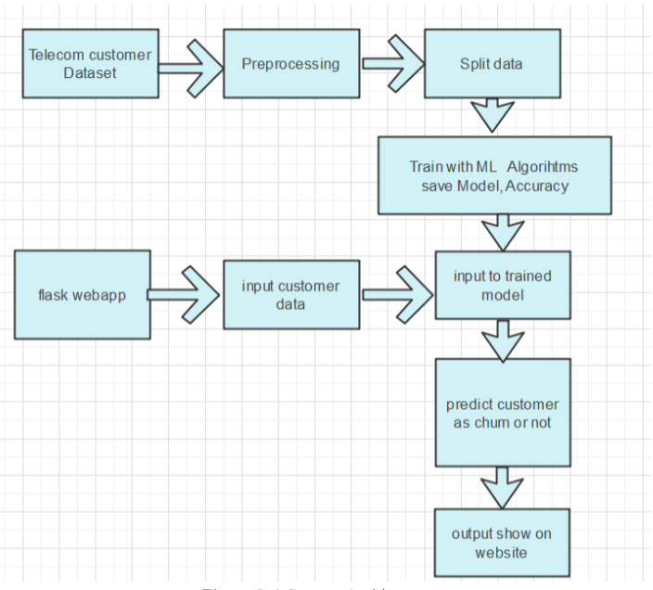
WORKFLOW

Slide 15
SYSTEM DESIGN
DATA COLLECTION:
IN this project we use telecom customer dataset collected from Kaggle which has few features related to connections and taken services features which are collected from churn prediction and 0 and 1 as labels.
PRE-PROCESSING:
our dataset consists of 30 features and even the evaluation of those lowest effective dose in the dataset. This method searches key features and selects all 30 features for training the machine using Machine learning models.Then split the data into test and train.Train the machine with 80% training data .This training data contains feature and label.Remain 20% split-up was used to test the machine learning model.

Slide 16
SYSTEM DESIGN
TRAIN-TEST SPLIT AND MODEL FITTING:
Now, we divide our dataset into training and testing data. Our objective for doing this split is to assess the performance of our model on unseen data and to determine how well our model has generalized on training data. This is followed by a model fitting which is an essential step in the model building process.
Model Evaluation and Predictions:
This is the final step, in which we assess how well our model has performed on testing data using certain scoring metrics, I have used 'accuracy score' to evaluate my model. First, we create a model instance, this is followed by fitting the training data on the model using a fit method and then we will use the predict method to make predictions on x_test or the testing data, these predictions will be stored in a variable called y_test_hat. For model evaluation, we will feed the y_test and y_test_hat into the accuracy_score function and store it in a variable called test_accuracy, a variable that will hold the testing accuracy of our model. We followed these steps for a variety of classification algorithm models and obtained corresponding test accuracy scores.

Slide 17
ALGORITHMS
Logistic regression
What it does: Logistic regression is a statistical method used for binary classification. It predicts the probability of a binary outcome (e.g., churn vs. non-churn) based on one or more predictor variables (e.g., customer demographics, usage patterns, and service data). The model uses a logistic function (sigmoid) to output probabilities between 0 and 1.
Why we are using it:
Simplicity & Interpretability: Logistic regression is easy to implement and understand. It's effective for problems where the relationship between the features and the target variable is approximately linear.
Baseline Model: It serves as a good baseline model. If logistic regression performs well, more complex models may not be necessary.
Probability Outputs: Logistic regression provides probability scores, which are valuable in customer churn prediction to estimate the likelihood of churn and take proactive actions.

Slide 18
ALGORITHMS
XGBoost (Extreme Gradient Boosting)
What it does: XGBoost is an advanced machine learning algorithm that belongs to the family of gradient boosting methods. It builds an ensemble of decision trees in a sequential manner, where each tree corrects the errors of the previous tree. XGBoost uses gradient descent to minimize errors, making it highly efficient.
Why we are using it:
Accuracy: XGBoost often provides top-tier performance in many machine learning tasks, especially with large and complex datasets.
Handling Overfitting: Through regularization, XGBoost reduces the risk of overfitting, making it ideal for noisy telecom data
Handling Missing Data: It can handle missing values internally, which is useful if there is missing information in customer records.

Slide 19
ALGORITHMS
Gradient-Boosted Machine (GBM) Trees
What it does: GBM builds an ensemble of weak learners (usually decision trees), where each tree learns to correct the errors made by the previous one. The "gradient" refers to the algorithm’s optimization process, where the gradient of the loss function is used to minimize prediction errors.
Why we are using it:
High Accuracy: GBMs are known for their accuracy, especially when dealing with large, high-dimensional data like telecom customer records.
Flexibility: They can be used for both regression and classification tasks. In churn prediction, they help determine the likelihood of a customer leaving.
Improved Performance: GBMs reduce errors effectively by focusing on hard-to-predict examples, improving the overall performance of the model.

Slide 20
ALGORITHMS
Random Forests
What it does: Random forests are an ensemble method that combines multiple decision trees. Each tree in the forest is trained on a random subset of the data, and the final prediction is made by averaging the results (for regression) or voting (for classification).
Why we are using it:
Reduced Overfitting: By averaging multiple trees, random forests reduce overfitting, making the model more generalizable to unseen data.
Robustness: Random forests are less sensitive to noisy data and can handle large datasets effectively.
Feature Importance: Like XGBoost, random forests also provide insights into the importance of features, which can help telecom companies identify factors influencing churn.
Versatility: They work well for both categorical and numerical data, which is essential when dealing with diverse customer information.

Slide 21
ALGORITHMS
Decision Trees
What it does: Decision trees are a flowchart-like structure where each internal node represents a decision based on a feature, and each leaf node represents a predicted outcome. The tree is built by splitting the data at each node in such a way that it maximizes the "purity" of the outcomes at the leaves (e.g., most customers who are likely to churn are grouped together).
Why we are using it:
Interpretability: Decision trees are easy to interpret and visualize. This makes them useful for understanding how specific features (e.g., customer tenure, usage patterns) affect churn.
Efficiency: They are computationally inexpensive and can be trained relatively quickly compared to more complex models like XGBoost.
Base Model for Other Ensemble Methods: Decision trees serve as the base learner in more advanced ensemble methods like random forests and gradient boosting.

Slide 22
PSEUDO-CODE
START
Step 1: Data Preparation LOAD customer_data CLEAN data (handle missing values, normalize numerical features, encode categorical variables) SPLIT data into training_set and testing_set
Step 2: Exploratory Data Analysis (EDA) ANALYZE features for patterns related to churn IDENTIFY important features (e.g., tenure, service usage, billing issues)
Step 3: Model Selection and Training DEFINE models = [Logistic Regression, Decision Tree, Random Forest, GBM, XGBoost]
FOR each model in models:
TRAIN model on training_set
PREDICT churn probabilities on testing_set
EVALUATE model using metrics (accuracy, precision, recall, F1-score, ROC-AUC)
STORE evaluation results

Slide 23
PSEUDO-CODE
Step 4: Select the Best Model
SELECT best_model based on evaluation results
IF best_model = Logistic Regression:
PRINT "Using Logistic Regression for churn prediction"
ELSE IF best_model = Decision Tree:
PRINT "Using Decision Tree for churn prediction"
ELSE IF best_model = Random Forest:
PRINT "Using Random Forest for churn prediction"
ELSE IF best_model = GBM:
PRINT "Using GBM for churn prediction"
ELSE:
PRINT "Using XGBoost for churn prediction"

Slide 24
PSEUDO-CODE
Step 5: Predict Churn Probabilities and Segment Customers
best_model.PREDICT churn_probabilities for all customers in customer_data
SEGMENT customers based on churn_probabilities:
IF churn_probability > 70%:
LABEL customer as "High-Risk"
ELSE IF churn_probability between 40% and 70%:
LABEL customer as "Medium-Risk"
ELSE:
LABEL customer as "Low-Risk"

Slide 25
PSEUDO-CODE
Step 6: Take Action Based on Segments
FOR each customer in High-Risk Segment:
OFFER retention strategies (e.g., discounts, personalized plans)
FOR each customer in Medium-Risk Segment:
ENGAGE proactively (e.g., check-ins, value-added services)
FOR each customer in Low-Risk Segment:
TARGET for upselling or cross-selling opportunities
Step 7: Continuous Improvement
SCHEDULE periodic model retraining with updated customer_data MONITOR model performance over time
END

Slide 26
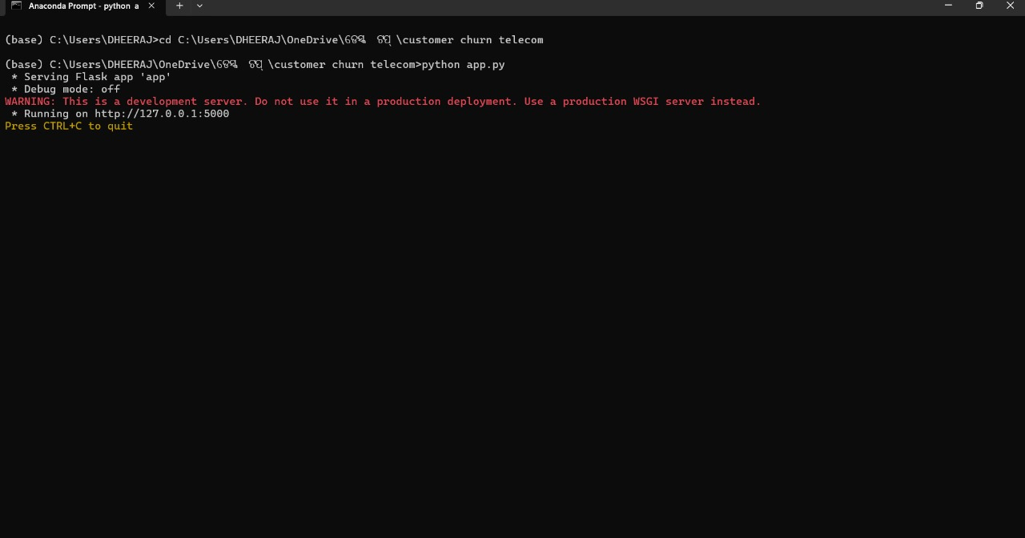
System implementation
The results focus on sophisticated churn prediction model that significantly improves telecom providers' ability to anticipate and address customer churn.
Fig .anaconda prompt
To execute the project, please follow these steps:
Open anaconda navigator application, run the flask_env in environments
Open the terminal, Copy the contents from the "customer churn telecom" file.
Type python app.py in Command prompt.
Upon successful execution, access the webpage below: [Please insert the webpage URL or description here.]

Slide 27
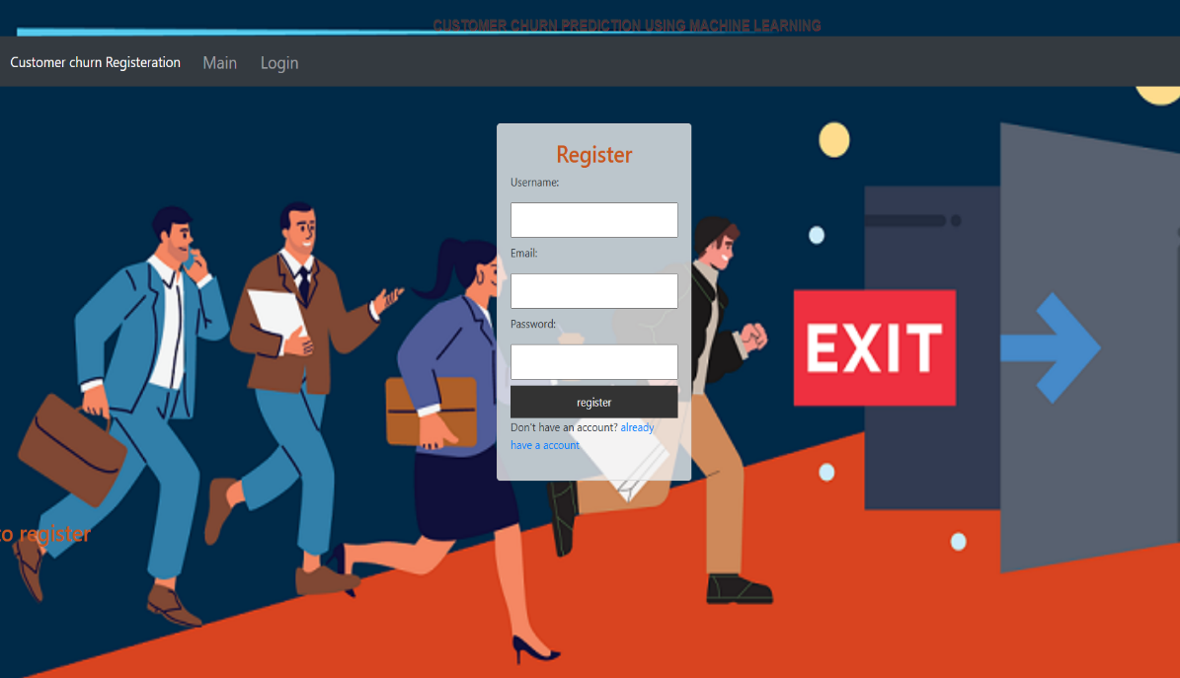
System implementation
Fig. Registration Page
A registration page for a customer churn prediction system requires several key components. First, input fields are used to collect essential information like username, email, and password, which form the basis for user authentication. Proper form validation is crucial to ensure the data is accurate and secure—validating email formats and enforcing strong password requirements helps maintain the integrity of user input.

Slide 28
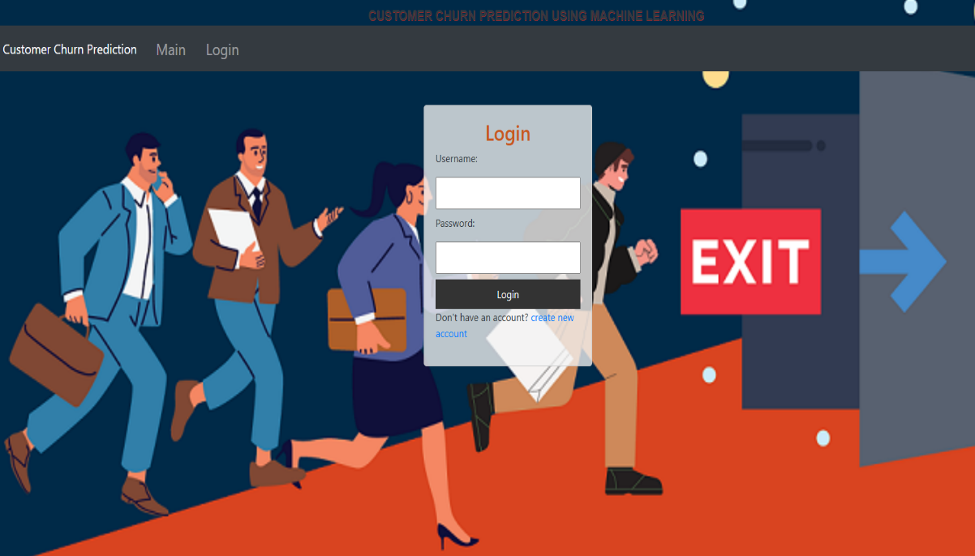
System implementation
Fig. Login Page
A login page for a customer churn prediction system serves as the gateway for users to access the application. It typically includes input fields for the username or email and password, enabling users to authenticate their credentials. Form validation is essential to ensure users enter correct and complete information, such as validating that fields are not left empty and that the email format is correct when applicable.

Slide 29
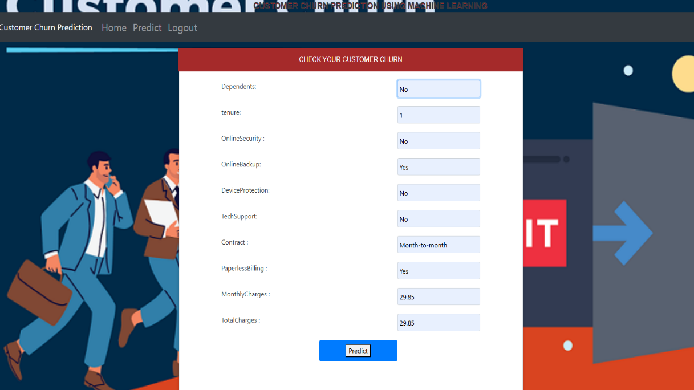
RESULT
A customer churn checking page for a customer churn prediction system serves as the interface where users can input customer data to assess the likelihood of churn. This page typically includes input fields to enter customer attributes such as demographic details, transaction history, and usage patterns.
Fig.5.1.3 Prediction Page
The page integrates with a backend machine learning model trained to predict churn based on these inputs. After the data is submitted, the model analyzes the inputs and returns a prediction indicating the likelihood of the customer leaving. The results are usually displayed in an easy-to-understand format, such as a probability score, risk category (e.g., high, medium, low), or a visual indicator like a color-coded status.

Slide 30
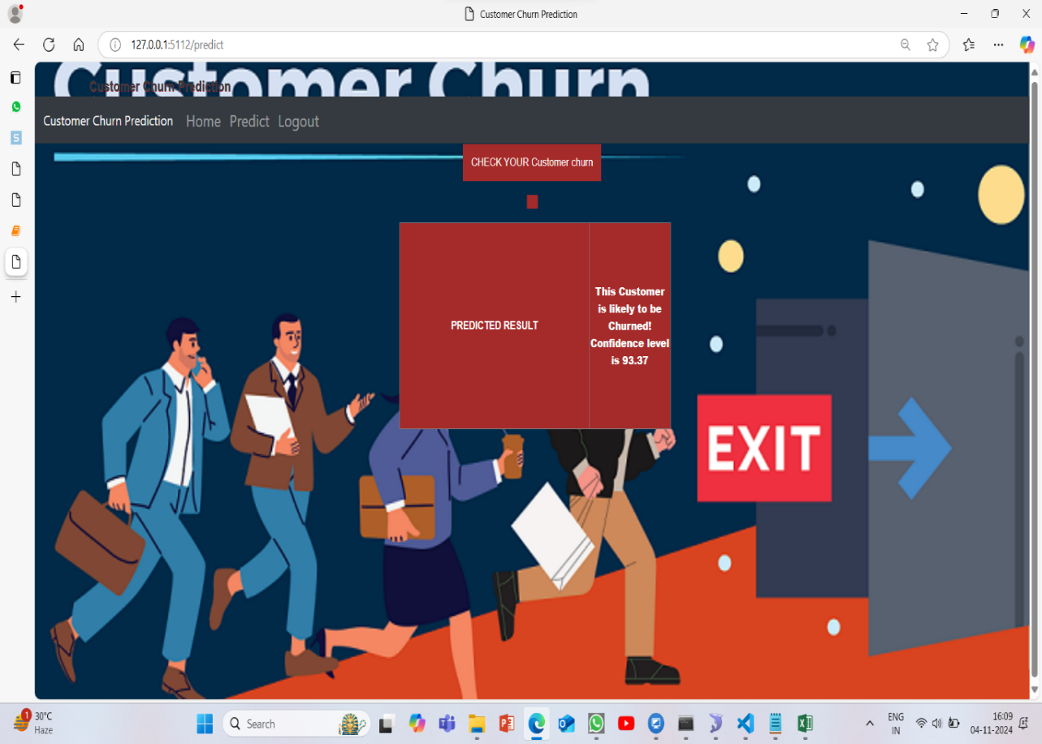
RESULT
Fig. Result page
A Churn Prediction Result Page for a customer churn prediction system provides users with insights into the likelihood of customer churn based on their input data. This page typically displays the prediction results, including whether a customer is likely to churn or not, along with key metrics and factors influencing the prediction.

Slide 31
RESULT
Key Components of the Churn Prediction Result Page:
1. Prediction Outcome: Clearly displays the prediction result, such as "Likely to Churn" or "Not Likely to Churn," giving a quick overview of the customer’s status.
2. Probability Score: Shows the probability or confidence level of the prediction, such as “Churn Probability: 93.37%,” helping users understand the certainty of the result

Slide 32
CONCLUSION
The purpose of this kind of study in the telecom industry is to aid businesses in increasing their profits. It is well known that one of the most significant revenue streams for telecom firms is churn prediction. The purpose of this study was to create a system that anticipates client attrition to be successful, prediction models must have high AUC values. The sampling data is split into 80% for training and 20% for validation in order to test or train the model. We picked to carry out for hyper - parameters adjustment and validation. To prepare the characteristics for machine learning algorithms, we used feature engineering, effective feature transformations, and selection methods. We also ran across the issue that the data was not balanced. Only 5% of the entries are customer turnover. This issue was resolved by under sampling or by utilising methods for trees that were not impacted by the issue. Due to their variety and suitability for this kind of predictions, four tree-based techniques were chosen. It includes the algorithms Decision Tree, Random Forest, and GBM tree.

Slide 33


